Slide 1
Secure Data Hiding in image using Steganography
CAPSTONE PROJECT
Presented By: THANGA SAI NAGA ANIRUDH
Student Name : THANGA SAI NAGA ANIRUDH
College Name : Vellore Institute of Technology Department : Btech – CSE (Specialization in AI & ML)

Slide 2
OUTLINE
Problem Statement
Technology used
Wow factor
End users
Result
Conclusion
Git-hub Link
Future scope

Slide 3
Problem Statement
Develop a Python-based Image Steganography application using OpenCV to securely hide and retrieve text messages within images.
The program should allow users to select an image, encrypt a secret message within the image using pixel manipulation, and save the modified image.
It should also enable decryption by extracting the hidden message upon entering the correct passcode.
The system must ensure data integrity, user-friendly interaction, and secure access to hidden messages.

Slide 4
Technology used
Programming Language:
Python (for scripting and image processing)
Libraries & APIs:
OpenCV – For image processing and pixel manipulation
OS Module – For handling file operations and opening images
Platform Compatibility:
Operating System: Windows, macOS, Linux
Python Version: Python 3.x
Development Environment: Jupyter Notebook, VS Code, or any Python IDE

Slide 5
Wow factors
Python-Based Image Steganography – Unlike GUI-based Java projects, this implementation uses a Python script with OpenCV for direct pixel manipulation.
Simple & Lightweight – No need for complex GUI frameworks; command-line interaction makes it easy to run on any system.
Efficient Encoding Mechanism – Uses RGB pixel manipulation to embed messages securely without noticeable image distortion.
Passcode Protection – Ensures that only authorized users can extract the hidden message.
Cross-Platform Compatibility – Runs on Windows, macOS, and Linux without requiring additional dependencies.

Slide 6
End users
Cybersecurity Enthusiasts & Researchers – Studying data hiding techniques.
Journalists & Whistleblowers – Securely transmitting sensitive information.
Students & Educators – Learning about cryptography and steganography.
Forensic Experts & Law Enforcement – Detecting hidden messages in images.
Privacy-Conscious Users – Hiding messages without traditional encryption.
Military & Intelligence – Secure covert communication.

Slide 7
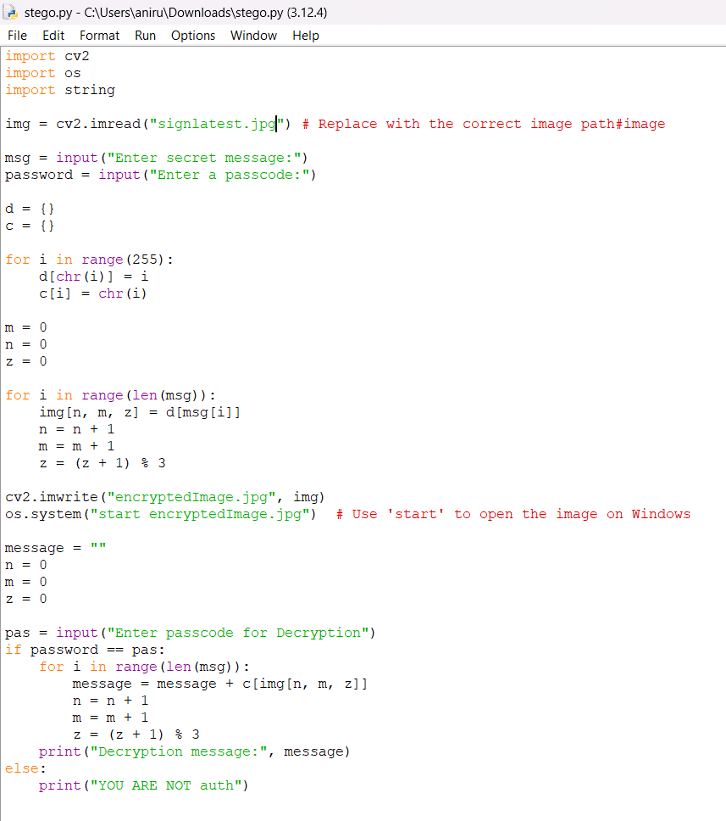
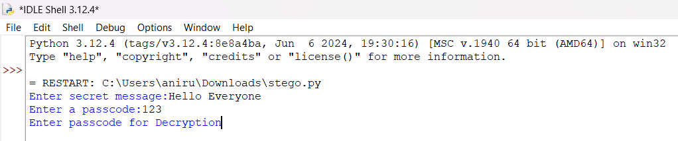
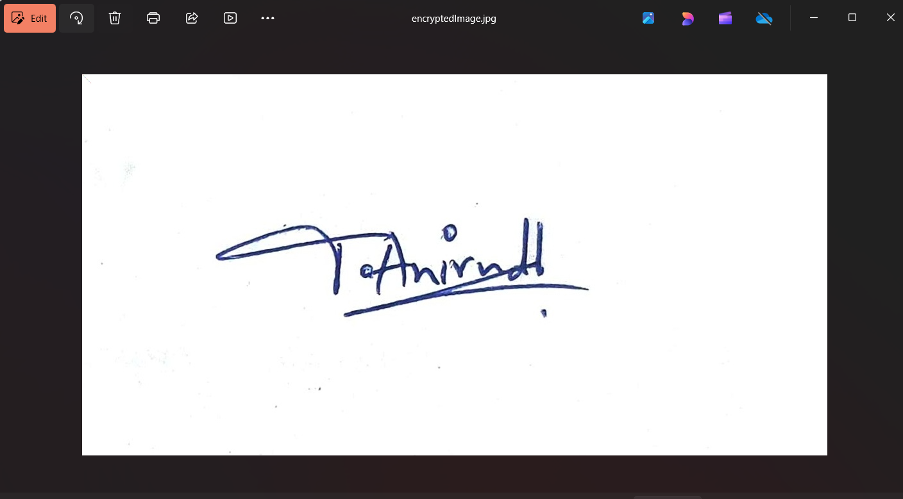
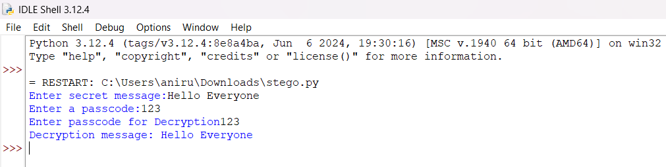
Results
<--SECRET MESSG
<--OUTPUT IMAGE
MAIN CODE →
<--DECRYPTION RESULT

Slide 8
Conclusion
This project demonstrates the use of Python and OpenCV for image steganography, allowing secure message hiding and retrieval. With a lightweight and efficient encoding method, it provides a robust solution for secure communication. Whether for cybersecurity professionals, military use, or privacy-conscious users, this tool ensures sensitive information remains protected.

Slide 9
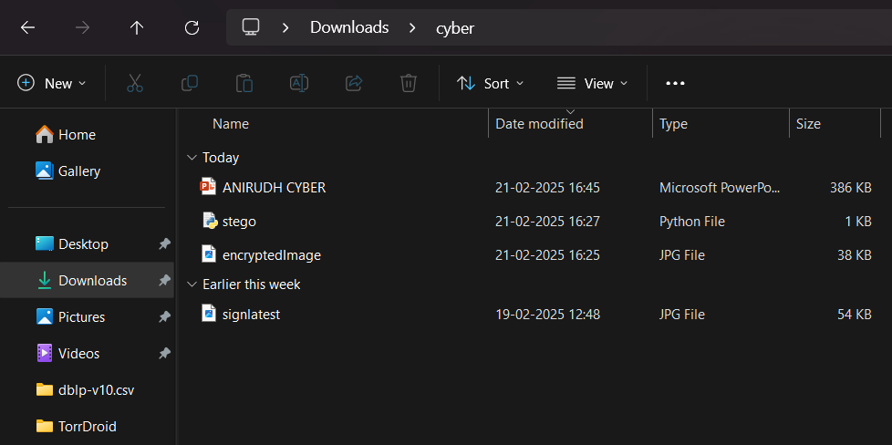
GitHub Link
https://github.com/SaiNagaAnirudh13/Steganography-INTERNSHIP.git

Slide 10
Future scope(optional)
Advanced Encryption Techniques – Integrating more sophisticated encryption algorithms like AES or RSA for added security in message encoding and decoding.
Steganography in Video – Expanding the project to embed messages in video files, providing an even more discreet medium for secure communication.
Mobile Application – Developing a mobile version of the tool for Android or iOS to allow users to easily perform steganography directly from their smartphones.
File Type Support – Enhancing the tool to support a wider range of file formats, such as PNG, BMP, or TIFF, for greater flexibility.
Watermarking Integration – Incorporating digital watermarking techniques for both image security and copyright protection in sensitive content.
Real-time Messaging – Allowing real-time encryption and decryption of messages exchanged through live video or streaming platforms.

Slide 11
THANK YOU

